Slide 1
Case interview Eidra Data Trainee - Mark peters

Slide 2
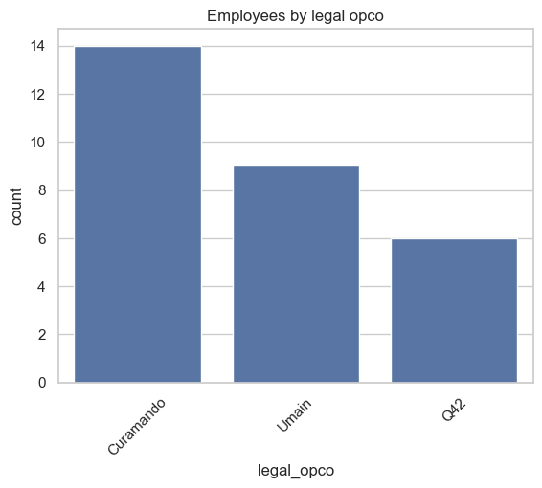

Chargeability
chargeability is a metric that measures the percentage of an employee's total working time that is billed directly to clients. It is frequently used interchangeably with "utilization" or "billable hours“.
Though it might be better to say:
Chargeability = Billable Hours / (Available hours –
Absence hours)

Slide 3
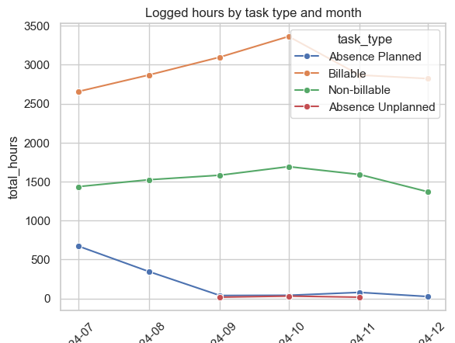
How does it look?
Considerations:
How many hours are logged as Billable / Non-billable / Absence Planned / Absence Unplanned?
Are there employees with missing time?
Are there employees hired mid-period or leaving mid-period?
Assumptions:
Billable hours are the numerator
Denominator is based on standard working calendar hours, not total logged hours.

Slide 4
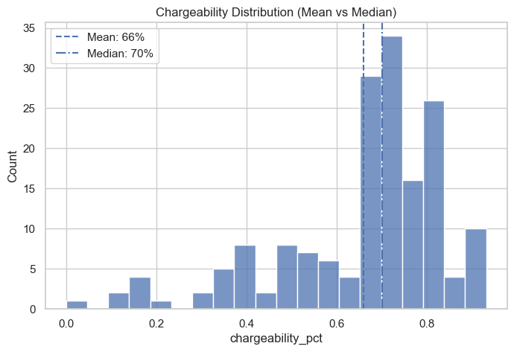
Key take-aways
High chargeability is common but unevenly distributed – skewed left
Absence-adjusted chargeability gives a much fairer picture e.g. Anna Lindberg absence: 80
Low chargeability often reflects role or staffing — not inactivity
Some employees are near full capacity (potential risk) – burnout, over-specialisation

Slide 5
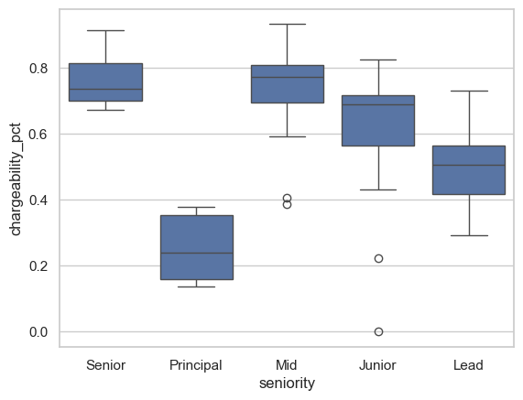
“don’t forget Oscar!” – individuals count
Factors to consider when judging low chargeability:
Junior staff:
Oscar Bergman – hired mid-month as a Junior. Had onboarding and training before working with clients. Clear ramp up – Aug: 22%, Dec: 72%
Principals:
Ella Pettersson, Sofie Dahl – involved in a lot of internal matters e.g. leadership & team management, sales & business development, internal strategy, and client relationship management.

Slide 6
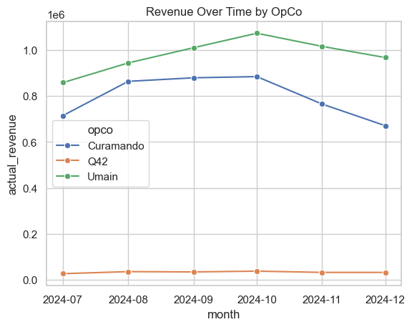
Revenue attribution
Revenue attribution in data science is the process of using data-driven models to identify which marketing touchpoints, campaigns, or customer interactions directly generated revenue.
In this case, this means how much of the money that was invoiced to a client can be traced back to each individual consultant.

Slide 7
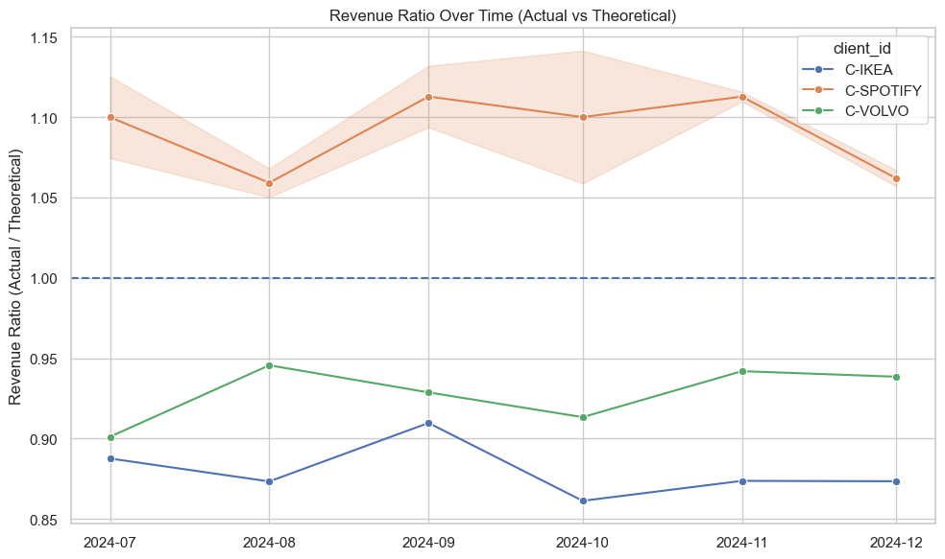
Follow the money! – key takeaways
Here are some of my observations:
Some clients are consistently underbilled e.g. IKEA, Ratio ~ 0.86–0.91. Gap: -40k to -64k SEK every month
Other clients are consistently overbilled (premium / efficient delivery) e.g. Spotify, Ratio ~ 1.05–1.11

Slide 8
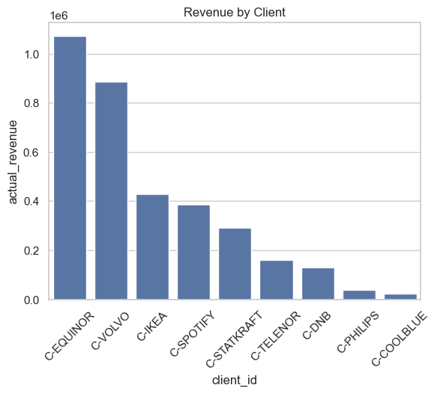
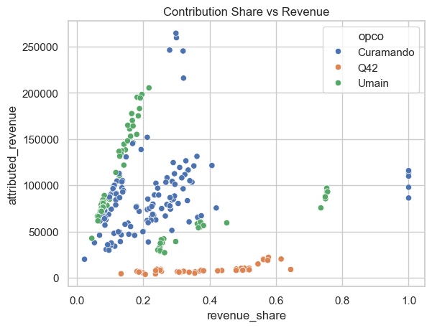
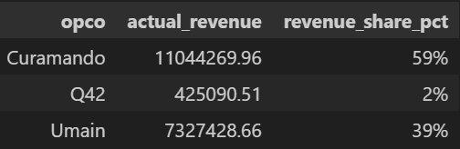
Follow the money! – more takeaways
Large clients drive the biggest financial impact.
Equinor + Volvo share: 56.66%
The rate of income is consistent across opco’s, especially between Curamando and Umain.

Slide 9
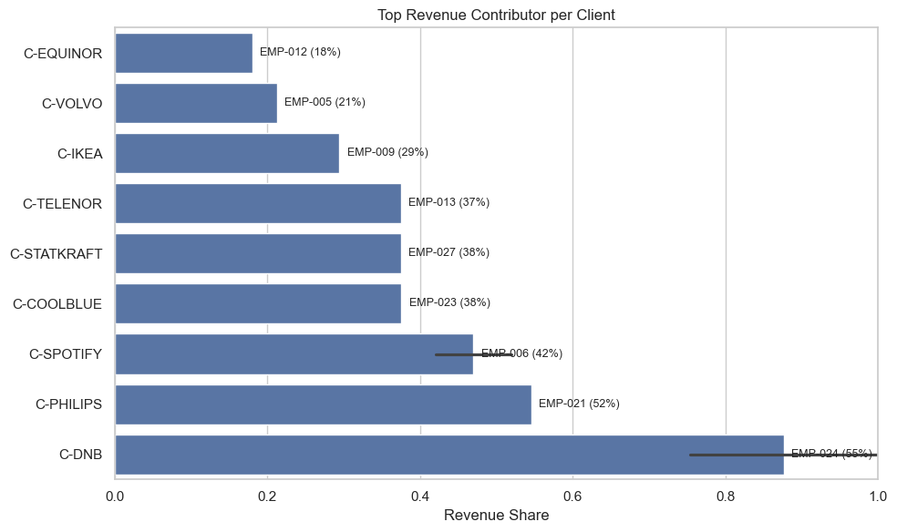
Combining both metrics - insights
There is an over-reliance on key customers, which leave the company vulnerable to sudden shifts in client loyalty. Also, small pricing inefficiencies at scale can have significant financial impact
Some employees are near full capacity, and are the sole consultant for a client e.g. DNB

Slide 10
Weird stuff
Observations that need more exploration
There were no part-time employees, and I’m not sure how that might have affected metrics.
Why was there a big drop in chargeability in Umain in November 2024?
Why is IKEA always undercharged and Spotify always over? Is it part of a business strategy?

Slide 11
recommendations
1. Improve Revenue Quality
Pricing reviews for underbilled clients
Adjust forecasting using revenue gaps
2. Reduce Business Risk
Diversify client portfolio – too much emphasis on core few
Reduce key-person dependency – too few doing too much
3. Align Performance Measurement
Introduce role-based KPIs – especially for Principles.
Track delivery efficiency

Slide 12
Thank you
Mark Peters
Data Trainee Presentation
Curamando

